Slide 1

YELP DATASETS
Course: GTATL20180515DATA
Date: July 28, 2018

Slide 2

TEAM BLUE SHIRTS
Team Members Include:
LaKeisha Ringo
John Giglio
Pride Hawkins
Stephen Wray

Slide 3

HYPOTHESIS:
Elite users write reviews that more closely reflect the star ratings than the total population of reviewers.

Slide 4

QUESTIONS:
Is the sentiment analysis of the individual reviews different by star ratings?
Is the individual elite review sentiment better correlated with the corresponding elite star rating then the reviews and star ratings of the total population?
Is the average elite review sentiment better correlated with the average elite star rating then the reviews and star ratings of the total population?

Slide 5

YELP DATASET BREAKDOWN:
1. Yelp has datasets that include:
a. 5,200,000 user reviews
b. Information on 174,000 businesses
c. The data spans 11 metropolitan areas
d. Website: https://www.kaggle.com/yelp-dataset/yelp-dataset/home
2. Yelp has two sets of users
a. Elite – “Elite-worthiness is based on a number of things, including well-written reviews, high quality tips, a detailed personal profile, an active voting and complimenting record, and a history of playing well with others.”
b. General which also includes elite users
3. Yelp has a 5-star system and ability to write a text statement for reviews on businesses

Slide 6

DATA PROCESSING AND EXPLORATION:
This data set was complete and was mostly stored in convenient data types.
Created subsets of reviews and businesses related to elite users.
Utilized VADER sentiment analysis to infer intent of written reviews
Used different criteria to aggregate and filter

Slide 7
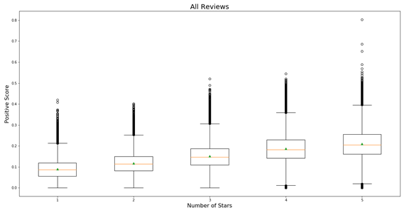
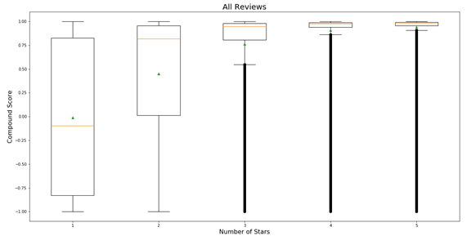
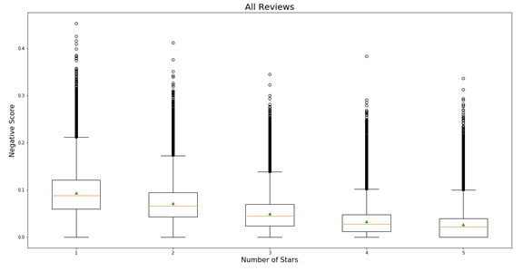
SENTIMENT ANALYSIS BY STAR RATING
95,286 1-star reviews
100,673 2-star reviews
159,025 3-star reviews
295,404 4-star reviews
307,680 5-star reviews

Slide 8
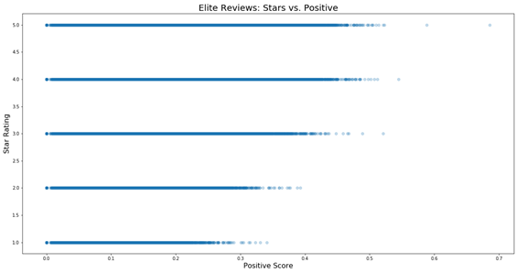
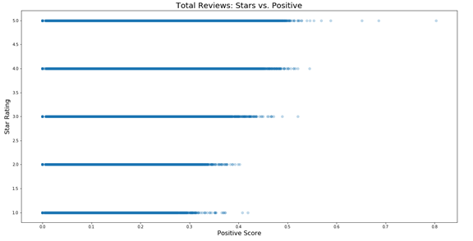
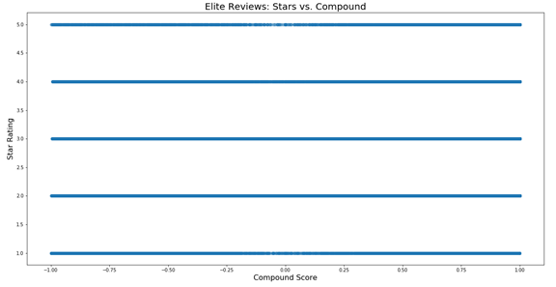
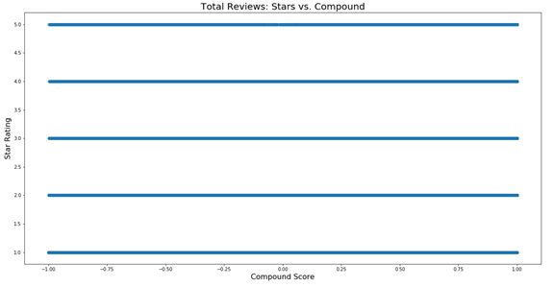
ELITE USERS VERSUS TOTAL USERS – INDIVIDUAL REVIEWS
Total Users
MSE
1.005
Variance Score:
0.406
Elite Users
MSE
0.789
Variance Score:
0.253

Slide 9
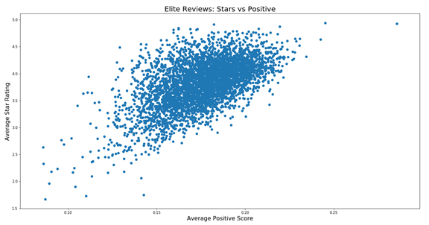
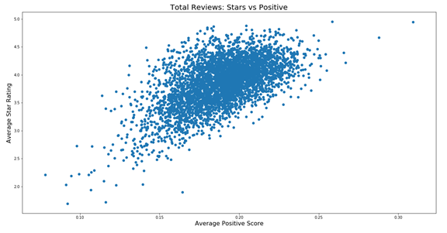
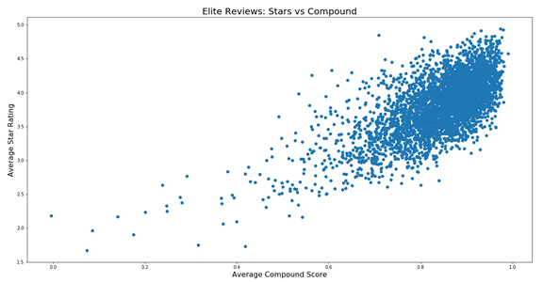
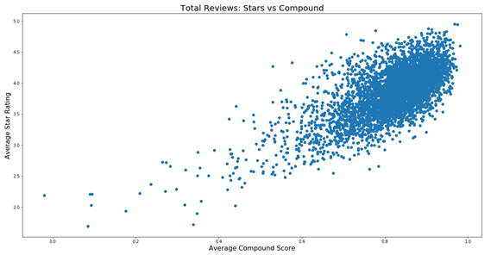
ELITE USERS VERSUS TOTAL USERS – AVERAGE BY BUSINESS
All Reviews
MSE
0.078
Variance Score:
0.546
Elite Reviews
MSE
0.087
Variance Score:
0.518

Slide 10

CONCLUSION:
No significant correlation found between the sentiment analysis of the individual text reviews and the individual star ratings.
A more linear relationship in the average sentiment analysis and average star rating per business.
Unable to conclude that the elite users contributions are significantly different than the total contributions of all reviewers.

Slide 11
POST MORTEM:
Spent a vast amount of time reviewing and exploring the datasets
Have plenty of ideas to elaborate on it

Slide 12

THE END
QUESTIONS AND ANSWERS SECTION

